Slide 1
[Computer Architecture Fundamentals and Concepts]
iAcademy
[Computer Architecture and Operating Systems] Lecture [6]
[Introduction to Operating Systems]
This lecture and its associated materials have been produced by [Bikash Bhattarai and MBA] of iAcademy for the purposes of lecturing on the above described subject and the material should be viewed in this context. The work does not constitute professional advice and no warranties are made regarding the information presented. The Author and iAcademy do not accept any liability for the consequences of any action taken as a result of the work or any recommendations made or inferred. Permission to use any of these materials must be first granted by iAcademy.

Slide 2
Agenda
iAcademy
Week 6 Lecture Coverage
  Introductions to operating systems
  Operating system evolution, hardware review, and operating system structure.

Slide 3
Learning Objectives
iAcademy
On successful completion of this lecture, students will be able to demonstrate:
– Understand role and functions of operating systems and its components

Slide 4
Review of Week 5
iAcademy
From fourth week we should have understood:
  Reduced instruction set computing (RISC)
  Complex instruction set computing (CISC)

Slide 5
Review of Week 5 (2)
iAcademy
Which computer architecture puts emphasis on hardware ?
Which are not the characteristics of RISC ?
  Stores registers-register
  Pipelining is used
  Instructions take a varying amount of cycle time

Slide 6

Q&A ?
iAcademy
Coursework
Submission

Slide 7
Introductions to operating systems
iAcademy
A modern computer consists of:
  One or more processors
  Main memory
  Disks
  Printers
  Various input/output devices.
Managing all these varied components requires a layer of software – the Operating System (OS).

Slide 8
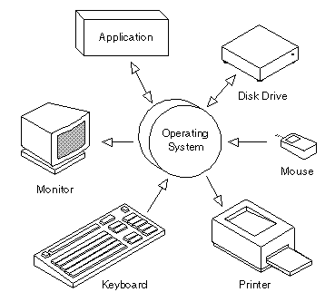
Introductions to operating systems
iAcademy
An Operating System (OS), is software that enables a user and higher-level application software to interact with a computer’s hardware and the data and other programs stored on the computer.
(OR)
An Operating
System is a
acts as an
program that
intermediary/interface between a user of a computer and the computer hardware.

Slide 9
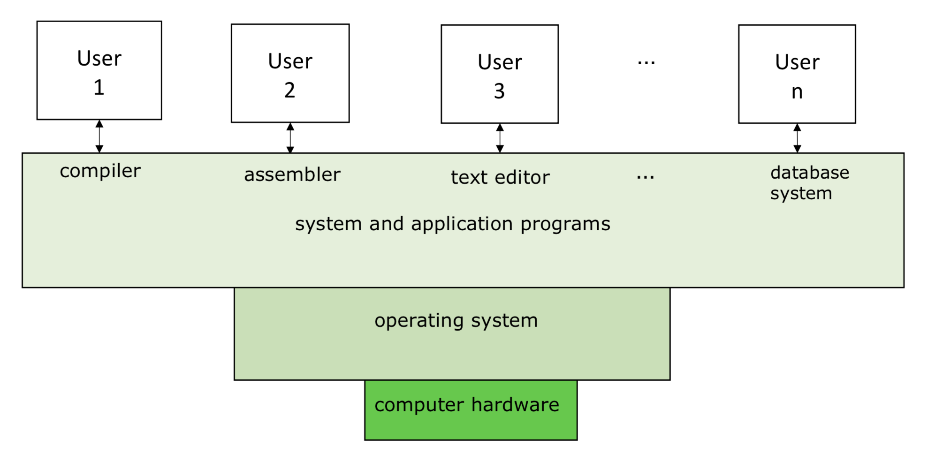

Slide 10
Operating System:
iAcademy
Functions:
  Resource Management (servers)
  Process Management (multiple programs)
  Storage Management (hard drives)
  Memory Management (RAM)
  Security & Privacy (Login)

Slide 11
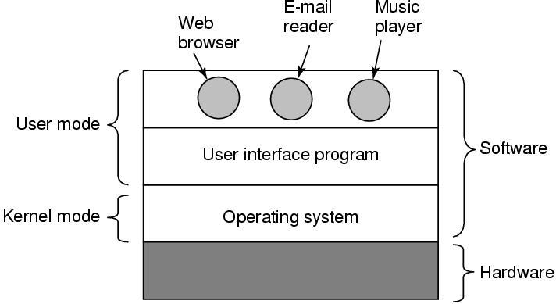
Introductions to operating systems
iAcademy
Where does the OS fit ?
Layers of Computer System

Slide 12
Kernel mode and OS
iAcademy
A Kernel mode is a computer system layer where it manages CPU resources, memory resources , hardware resources and any processes of any computer.
Kernel is only program running all the time on the computer system
Basically, OS fits in the Kernel mode and it has complete access to all the hardware and can execute any instruction the machine is capable of executing.

Slide 13
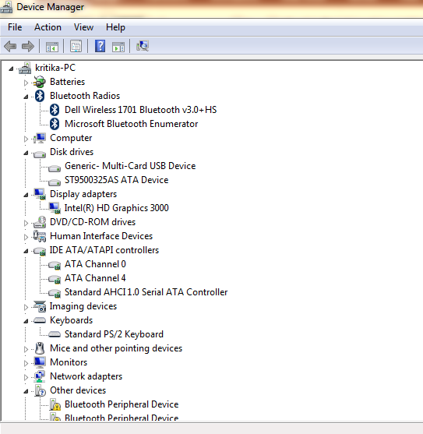
It has the device drivers in it. For example, if you have to do the networking, that goes through the Kernel. If you want to communicate through Bluetooth device, that goes through the Kernel. If you also want to use the file system, then it must go through the Kernel mode.

Slide 14
Introductions to operating systems
iAcademy
Services provided by OS:
  Facilities for program creation
    editors, compilers, debuggers, etc.
  Program execution
    loading in memory.
  Access to I/O and files
    deals with the specifics of I/O and file formats.
  System access
    resolves conflicts for resource contention.
    protection in access to resources and data.

Slide 15
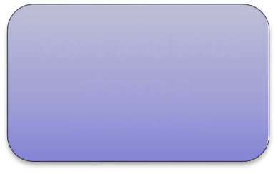
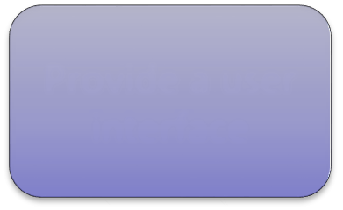
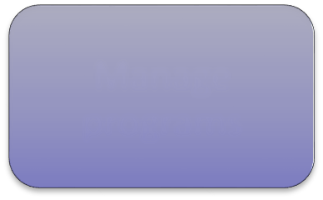
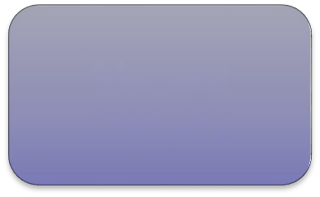
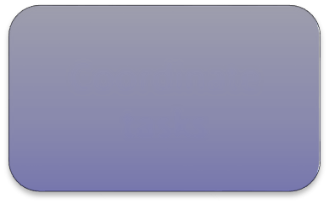
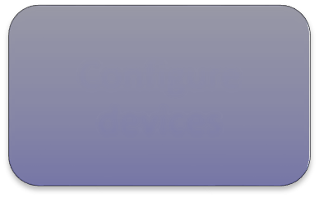
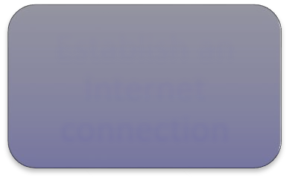
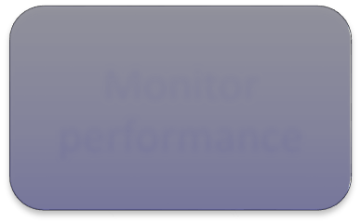
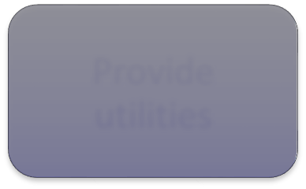
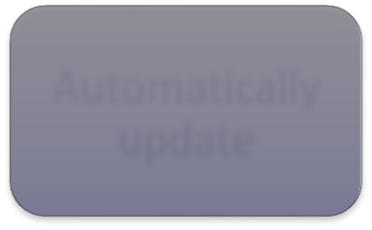
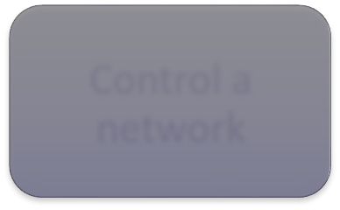
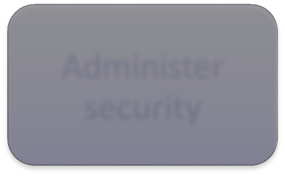
Operating Systems helps to:
iAcademy
Start and shut down a computer
Manage
programs
Manage
memory
Provide a user
interface
Coordinate tasks
Configure devices
Establish an Internet connection
Monitor performance
Provide
utilities
Automatically
update
Control a
network
Administer
security

Slide 16
OS Evolution, Hardware & Structures
iAcademy
Operating Systems Evolutions
  Serial Processing
  Batch Systems
  Multi programmed Systems
  Time-Sharing and Multitasking Systems
  Desktop Computers Multiprocessor
  Systems Networked/Distributed Systems

Slide 17
Batch System
Job(Program, Data & Information) in job pool
All job are kept in job pool
Submit to the Job operator
Operators together jobs(batch) as a group
The output send back to appropriate program
Disk technology allowed OS to keep all jobs on a disk OS perform job scheduling
Multi programmed System
To maximize the CPU load
At least one job needs to execute, CPU never sit idle Job Scheduling

Slide 18
Time-Sharing or Multitasking System
It is one of the extension of Multiprogramming
The executable multiple jobs with short frequency time while running Minimum response time
Resources are shared in many users
CPU scheduling and Multiprogramming are mechanism for its implementation
Multiprocessor or Parallel or Tightly coupled Systems
More than one processor with shared bus, clock, peripheral devices Sometimes even memory
Advanages: Increased throughput, Economy of sale, Increased reliability
Distributed System
Client-Server System
Centralized systems act as server systems
Server system satisfies the request generated by client

Slide 19
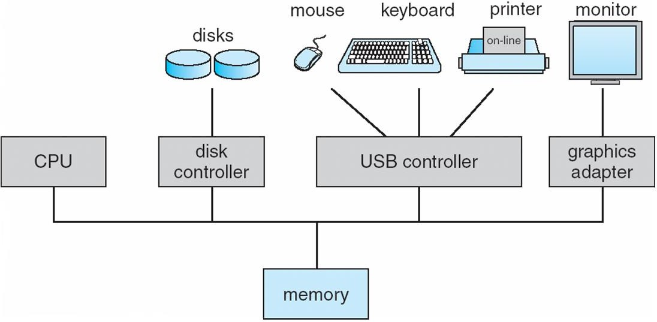
OS Evolution, Hardware & Structures
iAcademy
Computer Hardware Organization

Slide 20
OS Evolution, Hardware & Structures
iAcademy
Computer system components (1)
– Hardware – provides basic computing
resources
(CPU, Memory, I/O devices, Communication).
– Operating System – controls and coordinates use of the hardware among various application programs for various users.

Slide 21
OS Evolution, Hardware & Structures
iAcademy
Computer system components (2)
  System & Application Programs – ways in which the system resources are used to solve computing problems of the users (Word processors, Compilers, Web browsers, Database systems, Video games).
  Users – (People, Machines, other computers).

Slide 22
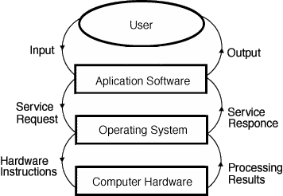
OS Evolution, Hardware & Structures
iAcademy
Dynamic views of system components

Slide 23
View points of OS
User Point of View
Computer System Point of View

Slide 24
OS - User Point of View
For ease of use, convenience
To maximize resource utilization
To compromise between usability and resource utilization

Slide 25
S y s t e m. View
iAcademy
Views of an Operating Systems
  There are three classical views (in literature):
    Resource Manager – manages and allocates resources.
    Control program – controls the execution of user programs (application software) and operations of I/O devices.
    Command Executer – Provides an environment for
running user commands.
  There is one modern view: Virtual Machine.

Slide 26
Resource Manager
iAcademy
  Manages and protects multiple computer resources: CPU, Processes, Internal/External memory, Tasks, Applications, Users, Communication channels, etc…
  Handles and allocates resources to multiple users or multiple programs running at the same time and space (e.g., processor time, memory, I/O devices). Mulitiplexing is performed to handle multiple programs/users.
  Decides between conflicting requests for efficient and fair resource use. (e.g. Minimize response time).
  bottom-up view.

Slide 27
iAcademy
Resource Manager oriented OS lists
  DEC RSX – Resource Sharing eXecutive
  MIT Multics
  IBM MFT/MVT – Multiple Fixed/Variable Tasks
  IBM MVS – Multiple Virtual Storage
  DEC VMS – Virtual Memory System
  IBM VM – Virtual machine

Slide 28
iAcademy
Control Program
  Manages all the components of a complex computer system in an integrated manner.
  Controls the execution of user programs and I/O
devices to prevent errors and improper use of
computer resources.
– Looks over and protects the computer: Monitor,
Supervisor, Executive, Controller, Master Coordinator
Sort of a black box view

Slide 29
iAcademy
Control Program oriented OS lists
  Unisys MCP – Master Control Program
  DR CP/M – Control Program/Microcomputer
  IBM VM/CP – VM Control Program
  IBM AIX – Advanced Interactive eXecutive
  DEC RSX – Resource Sharing eXecutive

Slide 30
iAcademy
Command Executer
  Interfaces between the users and machine.
  Supplies services/utilities to users.
  Provides the users with a convenient CLI (Command Language Interface), also called a Shell (in UNIX), for entering the user commands.
  GUI for executing graphical commands of User
  top-down view

Slide 31
iAcademy
Operating System as a virtual machine
  A virtual machine (VM) is a software program or operating system that not only exhibits the behavior of a separate computer, but is also capable of performing tasks such as running applications and programs like a separate computer. It is also known as a guest machine.
  An interface between the user and hardware that hides the details of the hardware (e.g., I/O).
  Constructs higher-level (virtual) resources out of lower- level (physical) resources (e.g., files).
  Example: VMware, KVM etc

Slide 32
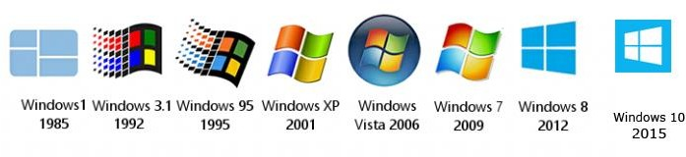
Evolution Of Windows OS
iAcademy
Start Menu, Taskbar, Maximize, Minimize and Close Button appeared for the first time.
25 languages. Windows XP also provided Help and Support feature.
The commands of MS-DOS were replaced by GUI
computers became the part of client/server computing.
The most secured Operating System- Windows Vista in 35 languages. User Account Control, BitLocker Drive Encryption were provided to protect the system data.
build mainly for the wireless devices such as laptops which started to overtake the desktops.
launched for Tablets, Laptops and PCs Start button was not include

Slide 33
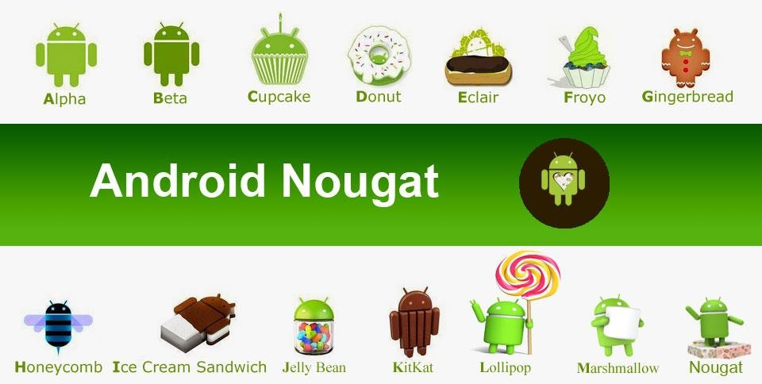
Evolution Of Android OS
iAcademy

Slide 34
Q&A ?
iAcademy

Slide 35
Summary
iAcademy
In this lecture we discussed
  Operating system
  OS evolution
  Different OS components
  Different OS types
  Operating System as virtual machine

Slide 36
Workshop
iAcademy
Each student will install Windows Operating System

Slide 37

iAcademy

